Slide 1
Combinatorial Pyramids – Development and Lessons Learned
David Pfahler
Structural Pattern Recognition

Slide 2
Recap Combinatorial Maps

Slide 3
Recap Combinatorial Maps
 | 1 | 2 | 3 | 4
a | 2 | 1 | 4 | 3
s | 4 | 2 | 3 | 1

Slide 4
Recap Combinatorial Maps
 | 1 | 2 | 3 | 4
a | 2 | 1 | 4 | 3
s | 4 | 2 | 3 | 1

Slide 5
Development Phases
Phase 1:
Existing Work
Phase 2:
Meet the Maps
Phase 3:
Implementation
Phase 4:
Results

Slide 6
Development Phases
Phase 1:
Existing Work
Phase 2:
Meet the Maps
Phase 3:
Implementation
Phase 4:
Results

Slide 7


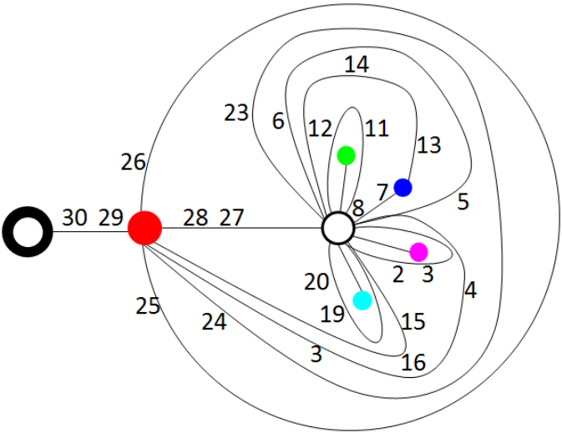
Phase 1: Existing Work
[Tor] is a Technical Report about operations on a Combinatorial Pyramid (CP).
[Tor]

Slide 8
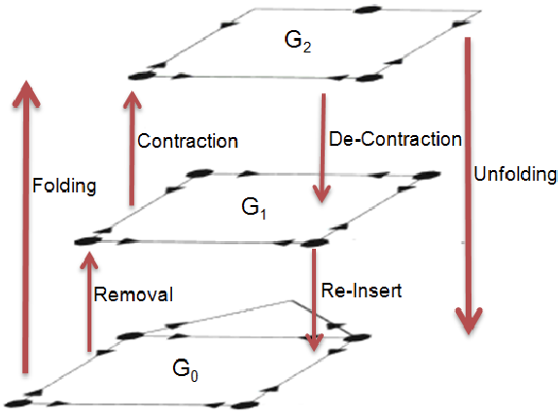
Phase 1: Existing Work
Recap: Operations on a Combinatorial Map (CM):
Remove
Contract
[Tor]

Slide 9
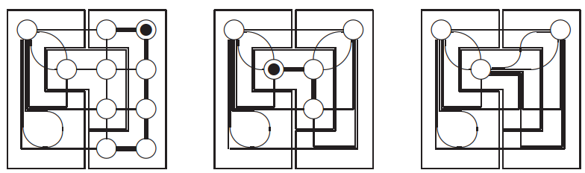
Phase 1: Existing Work
[Bru01] is an introduction to the CP. With background information an the contraction kernel.
[Bru01]

Slide 10
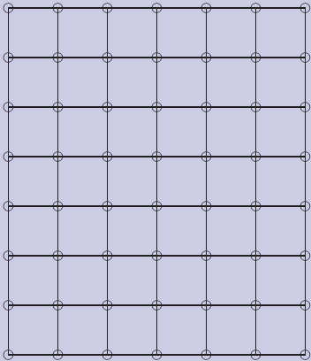
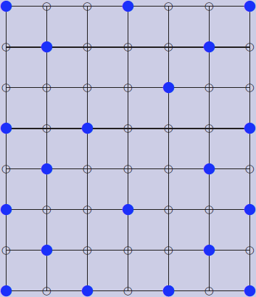
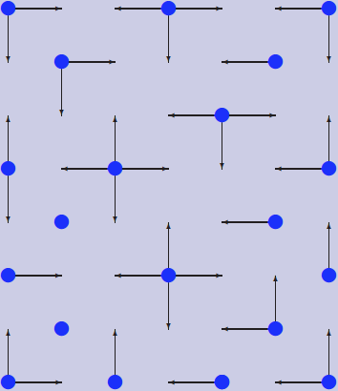
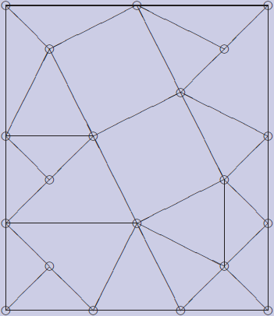
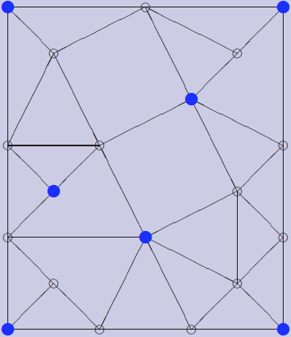
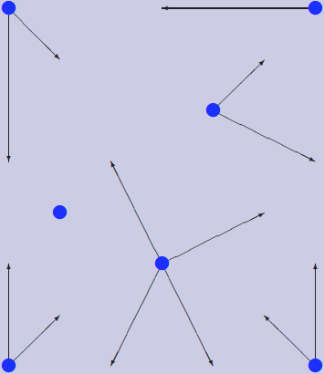
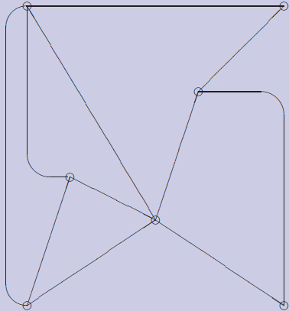
Phase 1: Existing Work
Recap: Contraction Kernel

Slide 11
Phase 1: Existing Work
[Bru03] describes contraction in parallel with contraction kernels
Recap: Problem why parallel contraction/removal is not trivial

Slide 12
Development Phases
Phase 1:
Existing Work
Phase 2:
Meet the Maps
Phase 3:
Implementation
Phase 4:
Results

Slide 13
Phase 2: Meet the Maps
I Implemented a simple python class for CM Not for computations but for representations
import CombinatorialMap
map=CombinatorialMap()
map.setSize(5, 5)
map.printNodes()

Slide 14
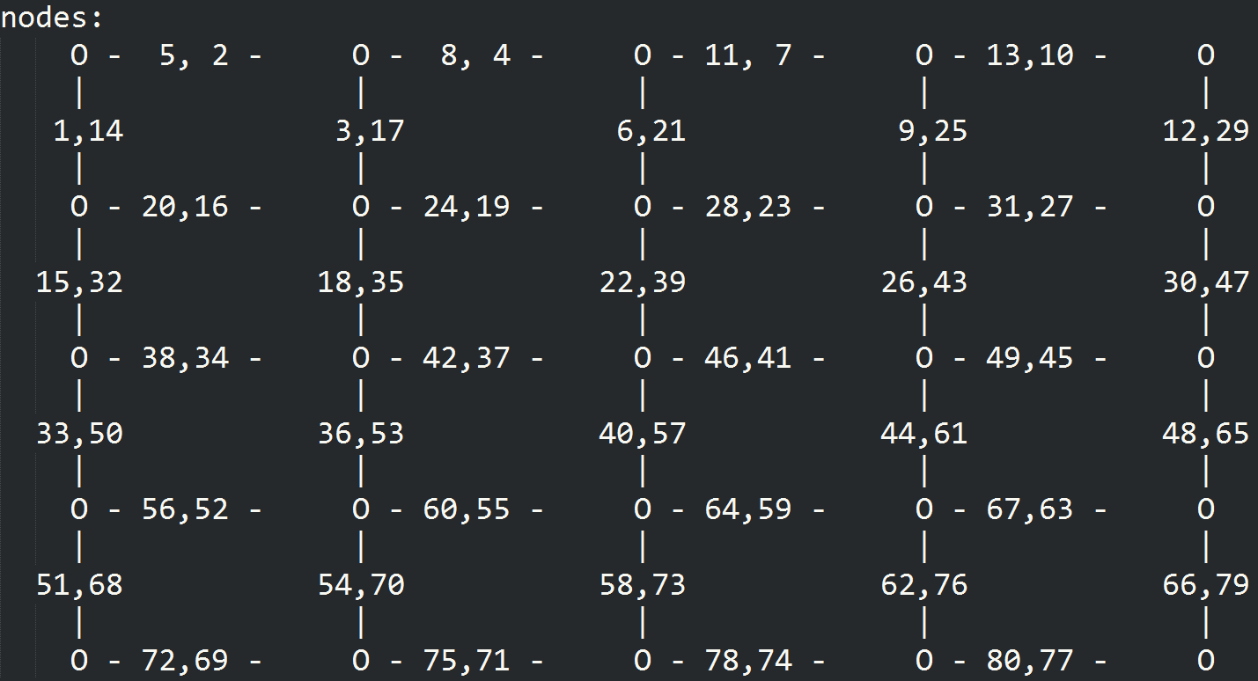
Phase 2: Meet the Maps

Slide 15
Phase 2: Meet the Maps
Also created functions to receive:
All darts with specific direction
All involutions of specific darts
The orbit of a vertex
All next darts
…

Slide 16
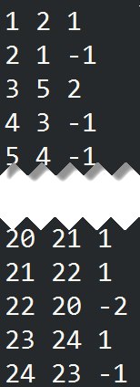
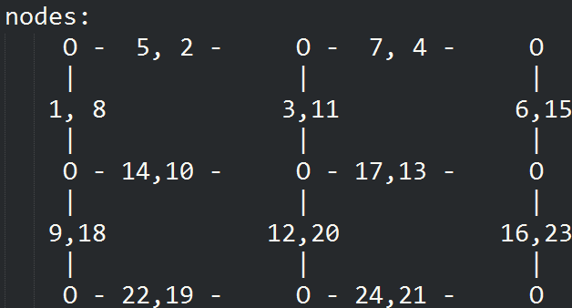
Phase 2: Meet the Maps
These are used to understand and create a CM from an image
d | s(d) | s(d)-d

Slide 17
Development Phases
Phase 1:
Existing Work
Phase 2:
Meet the Maps
Phase 3:
Implementation
Phase 4:
Results

Slide 18
Phase 3: Implementation

Slide 19
Phase 3: Implementation

Slide 20
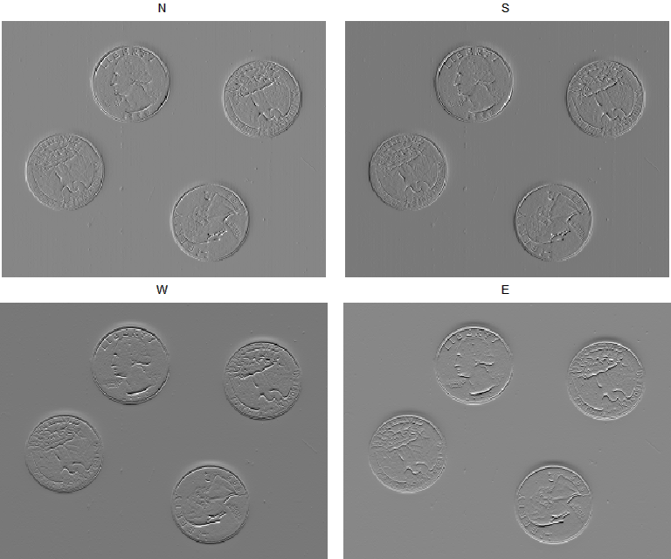
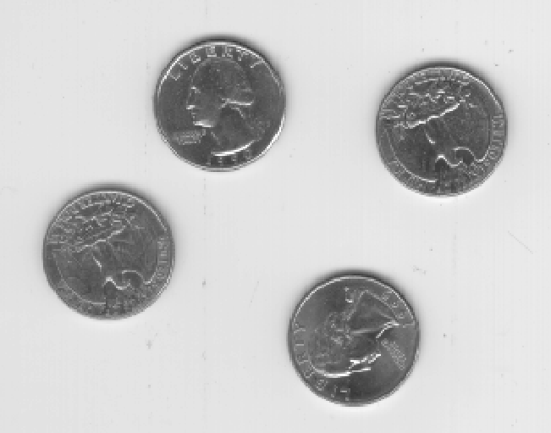
Compute Dart Values
A dart in an image is a transition from one pixel to another.
Compute from every pixel the change of the pixel value to every neighbor (N,E,S,W)

Slide 21
Phase 3: Implementation

Slide 22
Build Initial CP Level
Computation of the dart indices
Example South Indices:
Added by 4 inside the image. On the border it is only added by 3 (because the west dart is missing)
Also exceptions in the first row and the last row (missing north dart)
Additional exceptions for the corners

Slide 23
Build Initial CP Level
Computation of the next index:
one row:
repmat([2; 2; -1; -3], width-2, 1)
middle of the image:
repmat(
[next_darts_one_row; 1; 1; -2; 2; -1; -1],
height-2, 1)
Special cases for first and last row
d | s(d) | s(d)-d

Slide 24
Build Initial CP Level
Involution a
cm.involution(N) = S
cm.involution(E) = W
…
Previous Dart r
cm.prev(cm.next) = 1:num_darts

Slide 25
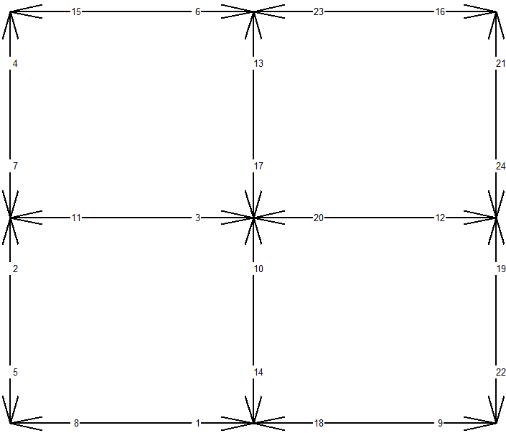
Build Initial CP Level
Some Examples (3x3):

Slide 26
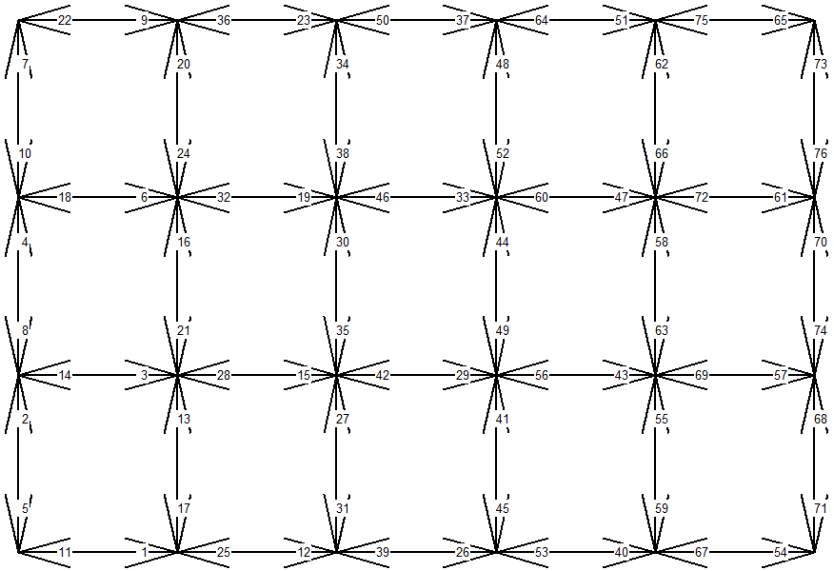
Build Initial CP Level
Some Examples (4x6):

Slide 27
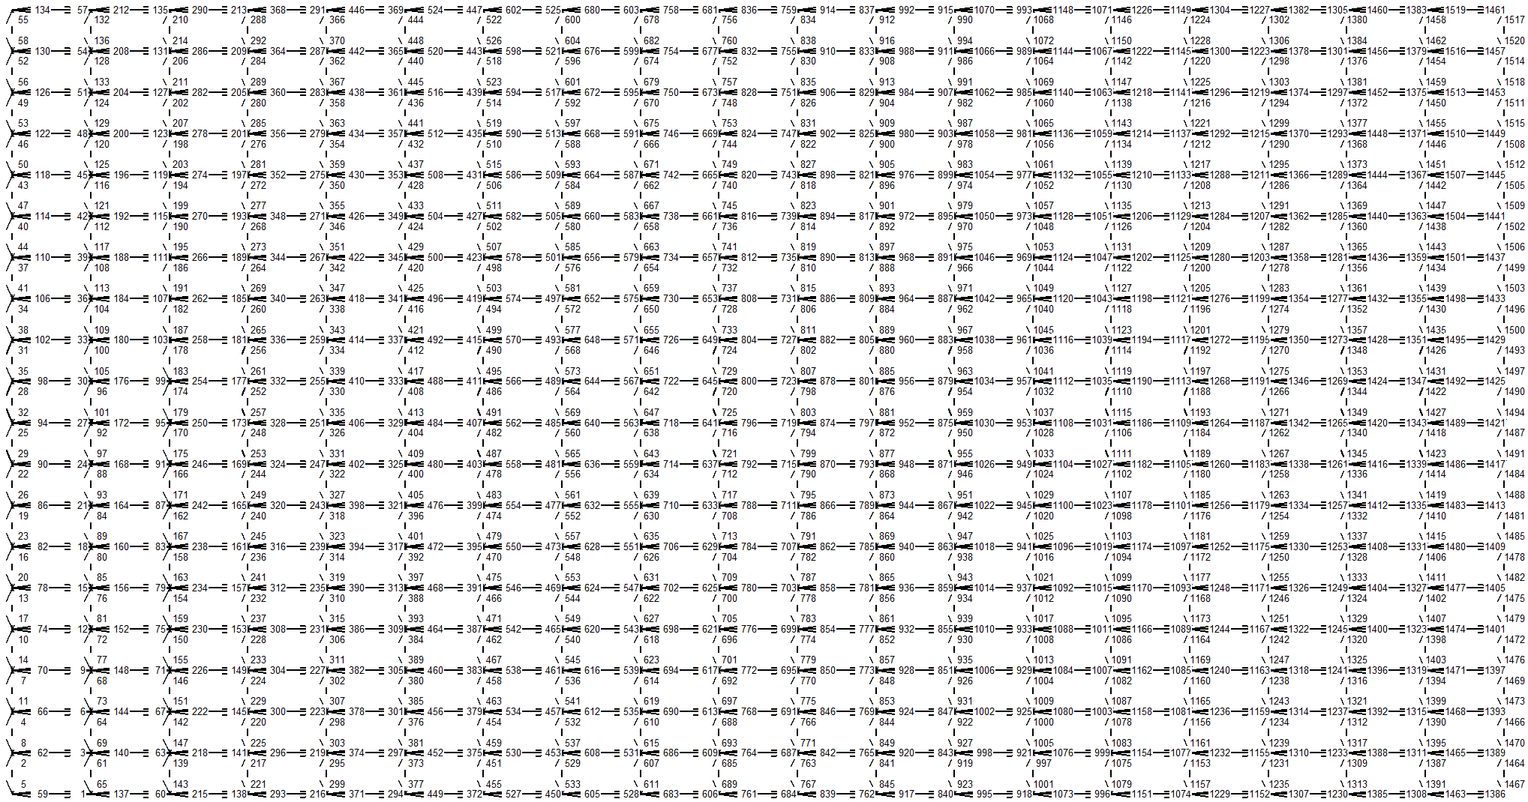
Build Initial CP Level
Some Examples (20x20):

Slide 28
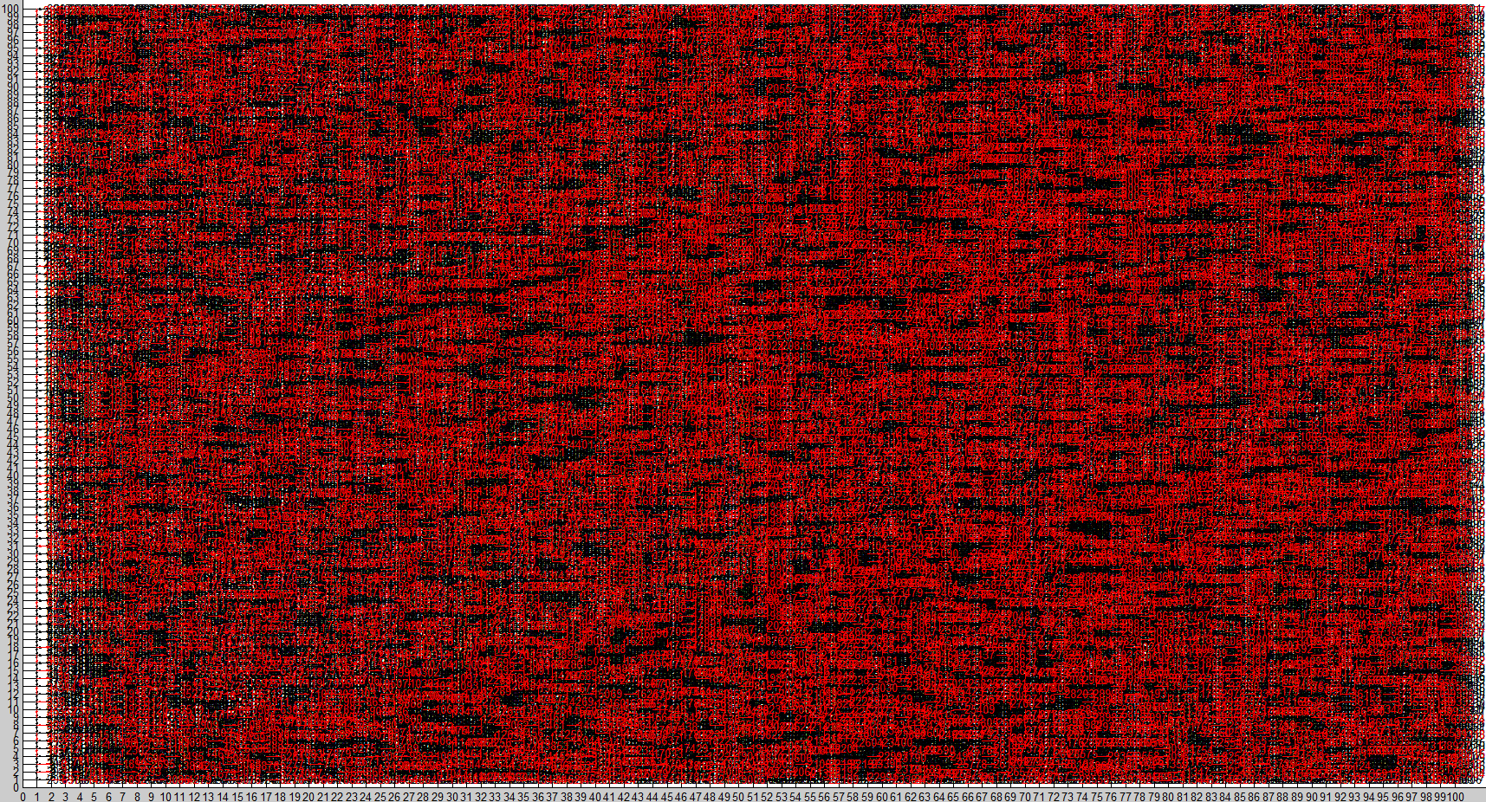
Build Initial CP Level
Some Examples (100x100):

Slide 29
Phase 3: Implementation

Slide 30
CP Creation
Contract Darts
Simplify Level
Compute Contraction Kernel

Slide 31
Compute the Contraction Kernel
Sort the darts by its values
Add dart to contraction kernel if:
Not self loop
Not pending edge
Contract Darts
Simplify Level
Compute Contraction Kernel

Slide 32
Compute the Contraction Kernel
Greedy: Assign next best Dart For Contraction Kernel
Contract Darts
Simplify Level
Compute Contraction Kernel

Slide 33
Compute the Contraction Kernel
Get the involution of the dart
Contract Darts
Simplify Level
Compute Contraction Kernel

Slide 34
Compute the Contraction Kernel
And the orbit of the involution
Contract Darts
Simplify Level
Compute Contraction Kernel

Slide 35
Compute the Contraction Kernel
Now remove the involution of the involution orbit from the set of valid darts
Contract Darts
Simplify Level
Compute Contraction Kernel

Slide 36
Compute the Contraction Kernel
Contract Darts
Simplify Level
Compute Contraction Kernel
Now get the orbit of the dart

Slide 37
Compute the Contraction Kernel
Contract Darts
Simplify Level
Compute Contraction Kernel
And remove its involution (except darts that are already in the kernel)

Slide 38
Compute the Contraction Kernel
Exceptions:
Self loops
Pending edges
Contract Darts
Simplify Level
Compute Contraction Kernel

Slide 39
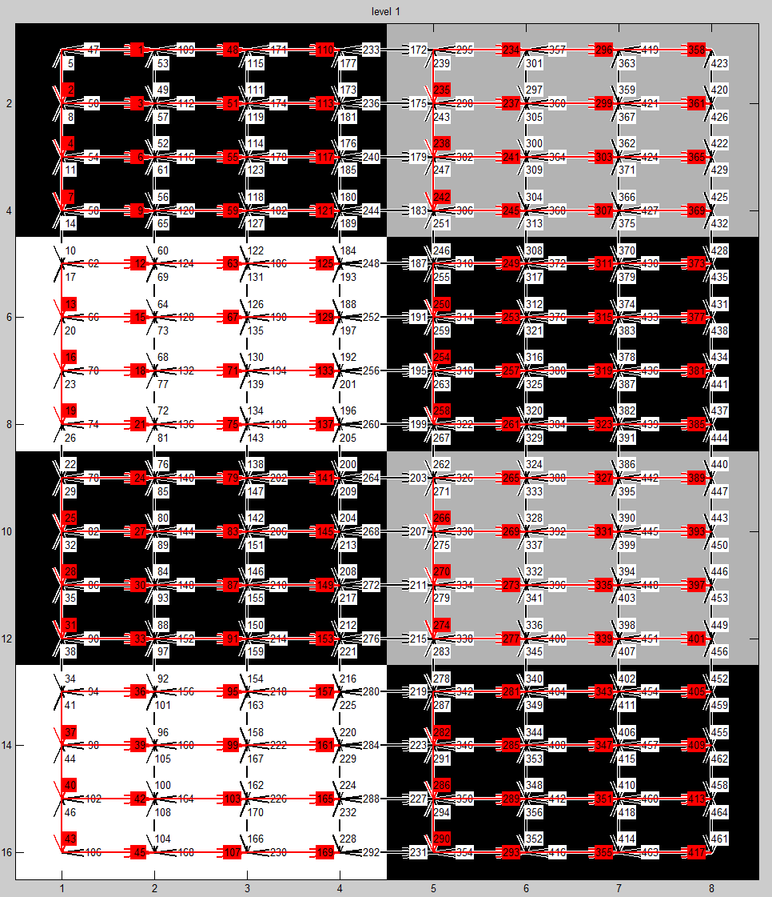

Compute the Contraction Kernel
Examples: Checkerboard

Slide 40
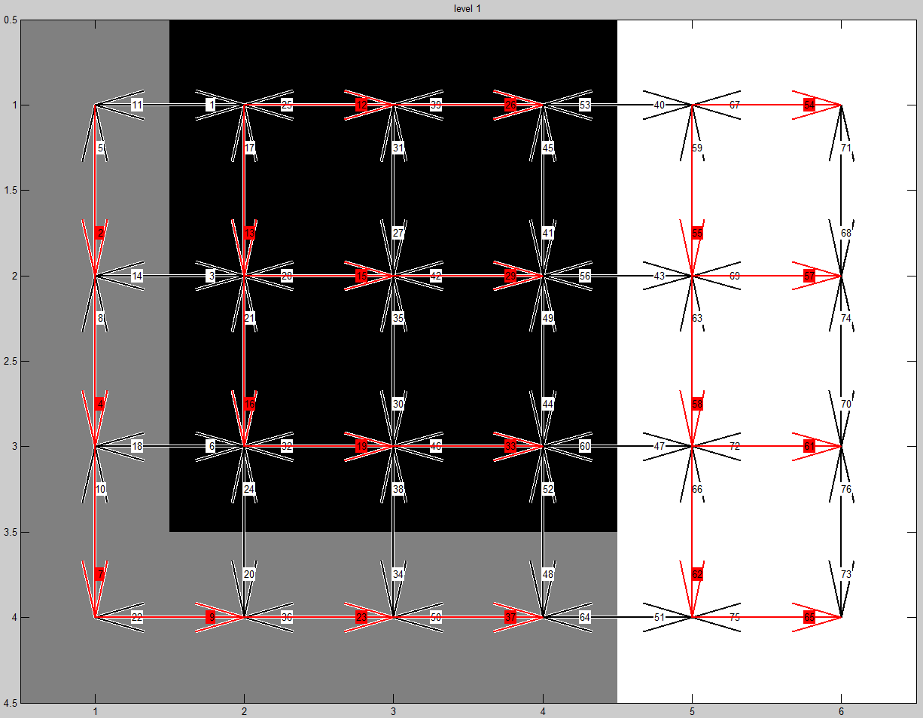
Compute the Contraction Kernel
Examples: Lecture

Slide 41
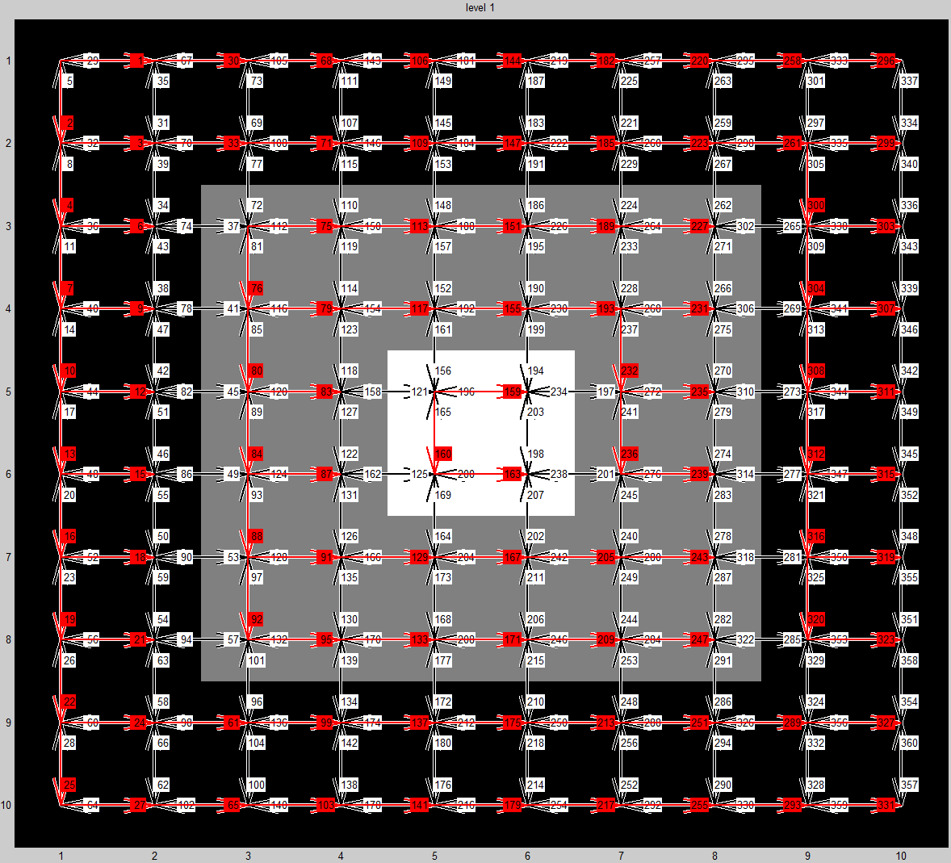
Compute the Contraction Kernel
Examples: Enclosure

Slide 42
CP Creation
Contract Darts
Simplify Level
Compute Contraction Kernel

Slide 43
CP Creation
Recap: Contract Darts
s
b
e
-x
d
a
x
c
darts | a | b | c | d | e | x | -x
s | x | a | d | e | -x | b | c
s’ | c | a | d | e | b | b | c
Contract Darts
Simplify Level
Compute Contraction Kernel

Slide 44
CP Creation
Recap: Contract Darts
s
s’
b
e
b
e
-x
d
d
a
x
a
c
c
darts | a | b | c | d | e | x | -x
s | x | a | d | e | -x | b | c
s’ | c | a | d | e | b | b | c
Contract Darts
Simplify Level
Compute Contraction Kernel

Slide 45
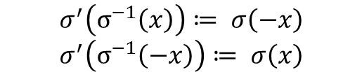
CP Creation
Recap: Contract Darts
s
s’
b
e
b
e
-x
d
d
a
x
a
c
c
darts | a | b | c | d | e | x | -x
s | x | a | d | e | -x | b | c
s’ | c | a | d | e | b | b | c
Contract Darts
Simplify Level
Compute Contraction Kernel
$$σ^{′}\left(σ^{−1}\left(x\right)\right)≔ σ\left(−x\right)$$
$$σ^{′}\left(σ^{−1}\left(−x\right)\right)≔ σ\left(x\right)$$

Slide 46
CP Creation
Contract Darts
Simplify Level
Compute Contraction Kernel

Slide 47
CP Creation
When contracting darts double edges and self-direct-loops are created. By removing these darts the pyramid is easier to read and faster to compute.
Contract Darts
Simplify Level
Compute Contraction Kernel

Slide 48
CP Creation
Check if the face of a dart has less than 2 darts:
Get face of this dart
Contract Darts
Simplify Level
Compute Contraction Kernel

Slide 49
CP Creation
Check if the face of a dart has less than 2 darts:
More than 2 darts!
Add all darts as valid
Contract Darts
Simplify Level
Compute Contraction Kernel

Slide 50
CP Creation
Check if the face of a dart has less than 2 darts:
Get face of this dart
Contract Darts
Simplify Level
Compute Contraction Kernel

Slide 51
CP Creation
Check if the face of a dart has less than 2 darts:
Contract Darts
Simplify Level
Compute Contraction Kernel
Number of darts in face is 2
→ can be removed!

Slide 52
CP Creation
Special cases for removal:
Self-Direct-Loops (2 cases)
Contract Darts
Simplify Level
Compute Contraction Kernel

Slide 53
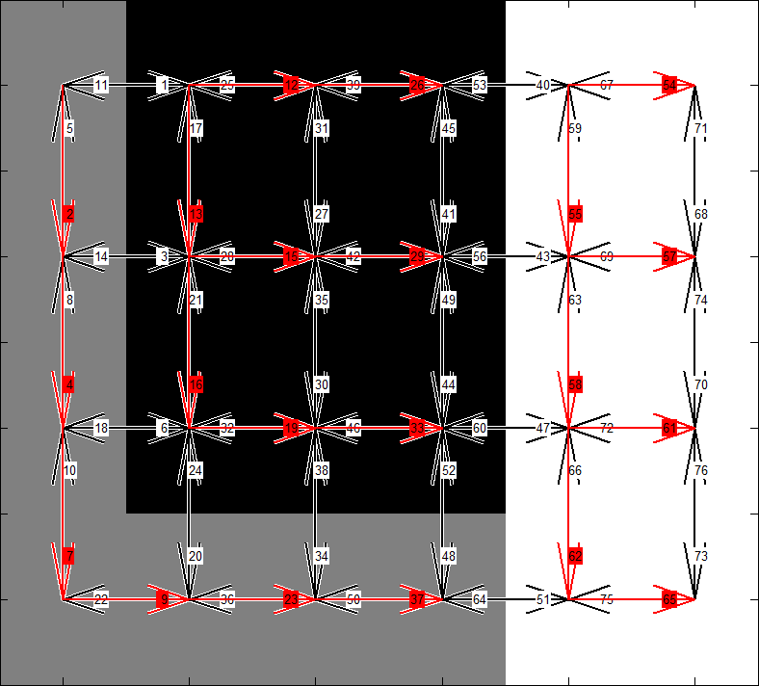
CP Creation
Example: contraction kernel (before contraction)
Contract Darts
Simplify Level
Compute Contraction Kernel

Slide 54
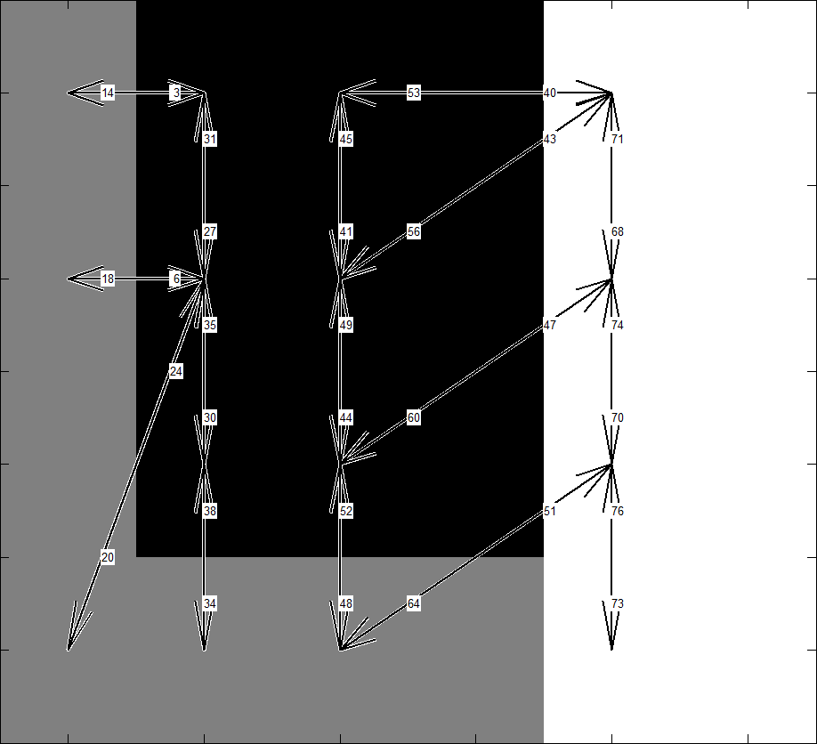
CP Creation
Example: after contraction
Contract Darts
Simplify Level
Compute Contraction Kernel

Slide 55
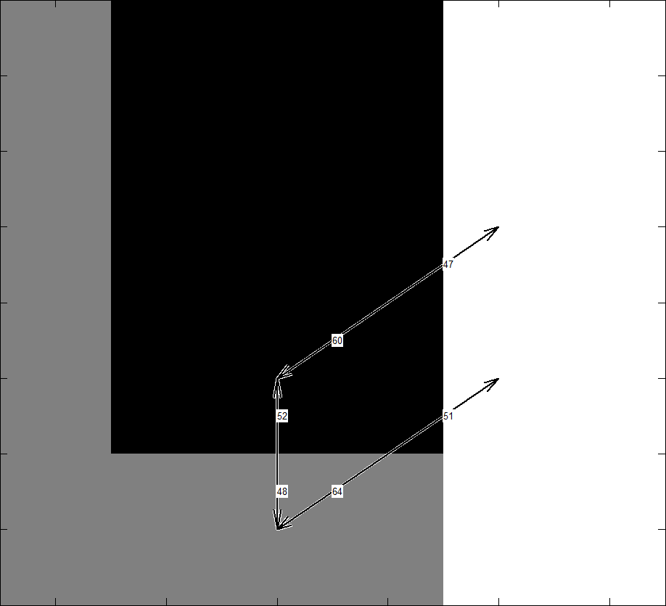
CP Creation
Example: after simplification
Contract Darts
Simplify Level
Compute Contraction Kernel

Slide 56
Development Phases
Phase 1:
Existing Work
Phase 2:
Meet the Maps
Phase 3:
Implementation
Phase 4:
Results

Slide 57
Phase 4: Results
DEMO

Slide 58
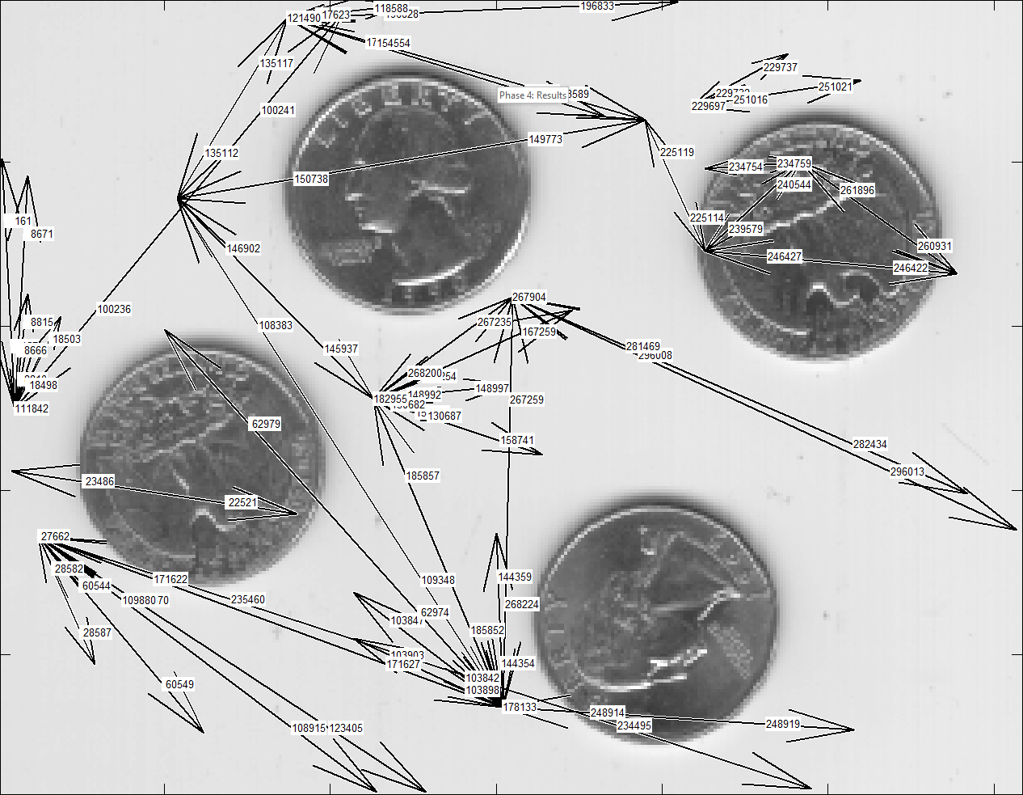
Phase 4: Results
Some costly examples:

Slide 59
Phase 4: Results
Some costly examples:
Computed dart values in t = 0.0081839
Build the first level in t = 0.034072
Pyramid level 1:
Computing contraction darts in t = 3.1576
Contracting darts in t = 1.5676
Simplify darts in t = 99.6362
Pyramid level 2:
Computing contraction darts in t = 0.52598
Contracting darts in t = 0.22664
Simplify darts in t = 7.4213
Pyramid level 3:
Computing contraction darts in t = 0.14502
Contracting darts in t = 0.052272
Simplify darts in t = 0.90517
Pyramid level 4:
Computing contraction darts in t = 0.04065
Contracting darts in t = 0.013697
Simplify darts in t = 0.13381
Pyramid level 5:
Computing contraction darts in t = 0.020479
Contracting darts in t = 0.0055467
Simplify darts in t = 0.029576
Pyramid level 6:
Computing contraction darts in t = 0.0089889
Contracting darts in t = 0.0038467
Simplify darts in t = 0.010096
Pyramid level 7:
Computing contraction darts in t = 0.03025
Contracting darts in t = 0.0028141
Simplify darts in t = 0.0046334
Pyramid level 8:
Computing contraction darts in t = 0.021293
Contracting darts in t = 0.00013621
Simplify darts in t = 0.0022108

Slide 60
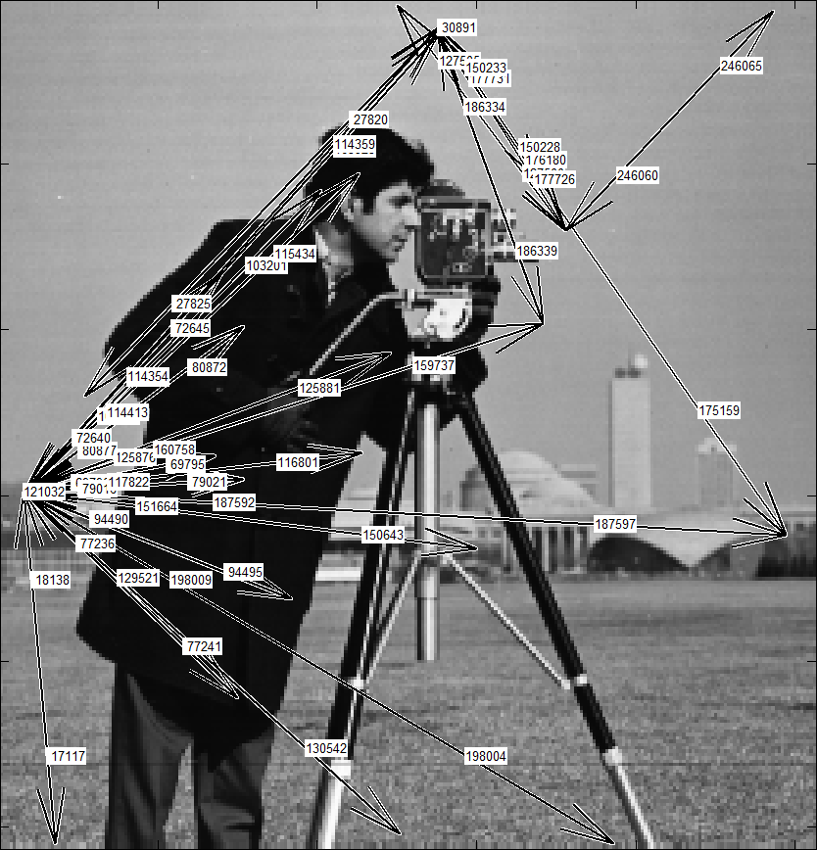
Phase 4: Results
Some costly examples:

Slide 61
Phase 4: Results
Some costly examples:
Computed dart values in t = 0.0040965
Build the first level in t = 0.028408
Pyramid level 1:
Computing contraction darts in t = 2.3352
Contracting darts in t = 1.0566
Simplify darts in t = 73.4445
Pyramid level 2:
Computing contraction darts in t = 0.66482
Contracting darts in t = 0.29912
Simplify darts in t = 12.5519
Pyramid level 3:
Computing contraction darts in t = 0.17884
Contracting darts in t = 0.077297
Simplify darts in t = 1.668
Pyramid level 4:
Computing contraction darts in t = 0.054448
Contracting darts in t = 0.021359
Simplify darts in t = 0.24825
Pyramid level 5:
Computing contraction darts in t = 0.016426
Contracting darts in t = 0.0073146
Simplify darts in t = 0.04384
Pyramid level 6:
Computing contraction darts in t = 0.010979
Contracting darts in t = 0.0039908
Simplify darts in t = 0.013091
Pyramid level 7:
Computing contraction darts in t = 0.008718
Contracting darts in t = 0.003313
Simplify darts in t = 0.004469
Pyramid level 8:
Computing contraction darts in t = 0.015805
Contracting darts in t = 0.0001234
Simplify darts in t = 0.0020848

Slide 62
Literatur
[Tor] Torres, Fuensanta, and Walter G. Kropatsch. "Canonical Encoding of the Combinatorial Pyramid.“
[Bru01] Brun, Luc, and Walter Kropatsch. "Introduction to combinatorial pyramids." Digital and image geometry. Springer Berlin Heidelberg, 2001.
[Bru03] Brun, Luc, and Walter Kropatsch. "Contraction kernels and combinatorial maps." Pattern Recognition Letters 24.8 (2003): 1051-1057.

